Slide 1
Title of the Project : University Attendance Tracker and Grading System
Team Number : 12
Group members:
M.Sai Saranya – 2620030228
K.Raghuveera Reddy - 2620030467

Slide 2
Abstract
The University Attendance Tracker and Grading System is a software based system designed to simplify and manage student attendance and academic performance.
The system allows faculty members to record and update student attendance digitally, reducing the manual work and errors.
It can calculate attendance percentages automatically and maintain student attendance records in an organized manner.
Students can view their attendance percentage,grades and marks helping them monitor their academic progress.
The system can generate reports for faculty making academic report management faster and more efficient.
Overall, the system provides a user friendly solution for managing attendance and grading, improving accuracy , reducing paperwork, and supporting better academic monitoring.

Slide 3
Understanding Problem Statement
In universities, managing student attendance and academic grades can be difficult when records are maintained manually.
Faculty members spend a lot of time recording attendance, calculating attendance percentages, entering marks and assigning grades.
Manual record keeping can also lead to calculation errors, missing records, and difficulty in finding student information.
Students may find it difficult to know their current attendance percentage and academic performance.
There is a need for a simple system that brings attendance, marks and grades together at one place.
The University Attendance Tracker and Grading System is proposed to solve all these issues by providing a digitalized platform.
It helps faculty manage attendance percentages and grades efficiently allowing students to monitor their academic progress.

Slide 4
CO 1 Topics
Data types : int , char, Boolean , String
Variables : Student Id, attendance count, marks , percentage
Constants : minimum attendance requirement ex:85%
Operators : Arithmetic, logical, relational and assignment operators
Type casting: Converting counts to double for percentage.

Slide 5
Co 2 TOPICS
If
If else
Else if ladder
Switch statement
Loops

Slide 6
CO 3 Topics
Methods
Parameters or return values
Arrays
Array searching and counting
Average and total

Slide 7
CO4 Topics
Classes
Objects
Constructors

Slide 8
CO5 Topics
Strings
Saving the information in files

Slide 9
Conclusion
The University Attendance Tracker and Grading System is designed to manage student attendance and academic performance efficiently.
It stores student details using file handling in Java.
The system calculates attendance percentages and grades automatically.
It identifies students whose attendance is below 85%.
It also helps users search and view student records easily.
Java Streams are used to filter students based on specific conditions.
Object-oriented programming makes the system organized and easy to maintain.
The project reduces manual work and saves time.
It also helps improve the accuracy of attendance and grade calculations.
Overall, this project provides a simple and useful solution for university student record management.

Slide 10
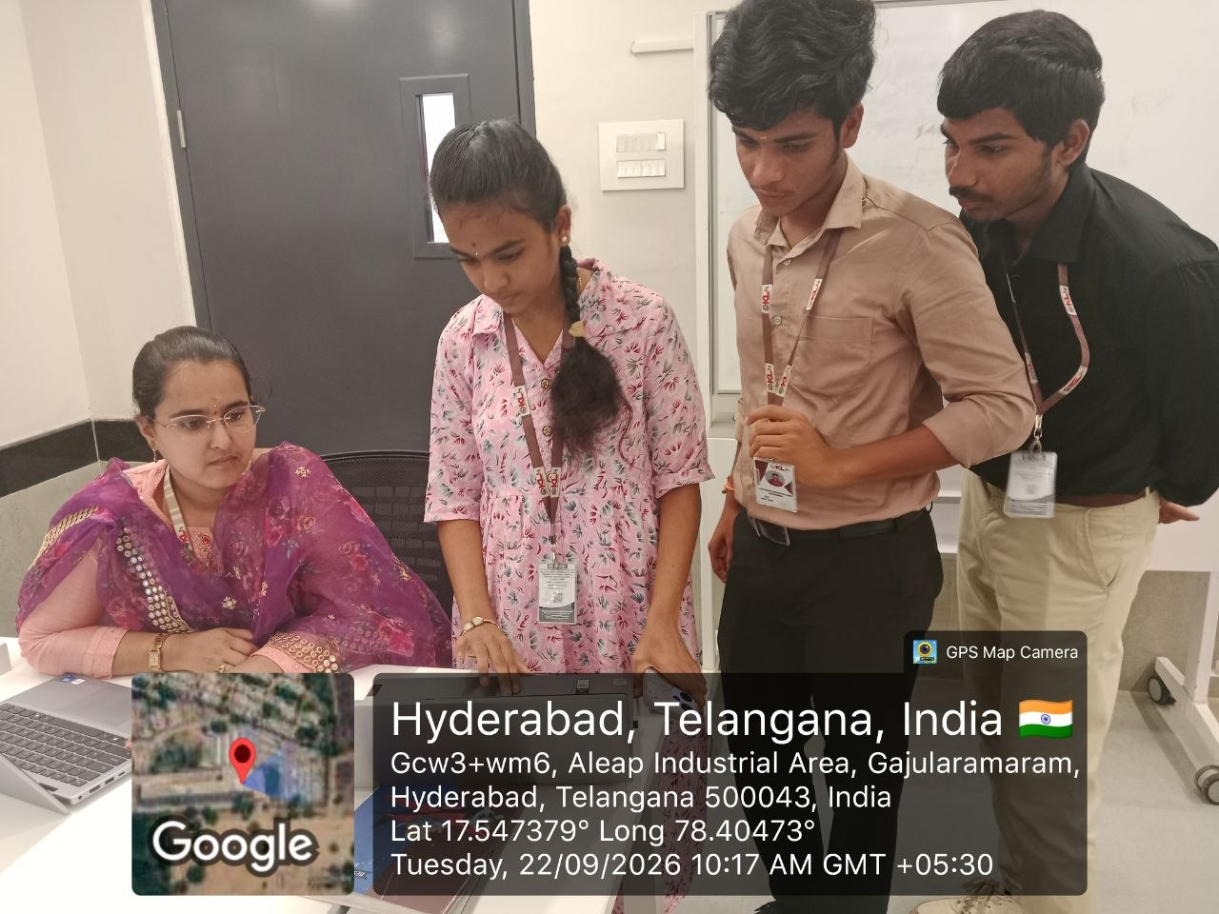
GeoTag Photo:

